Slide 1
Vertebrates & Invertebrates
www.ecosystemforkids.com
Science for 1st to 7th Grades

Slide 2
Vertebrates
An animal of a large group distinguished by the possession of a backbone or spinal column, including mammals, birds, reptiles, amphibians, and fishes.
Invertebrates
An animal lacking a backbone, such as an arthropod, mollusk, annelid, coelenterate, etc.

Slide 3
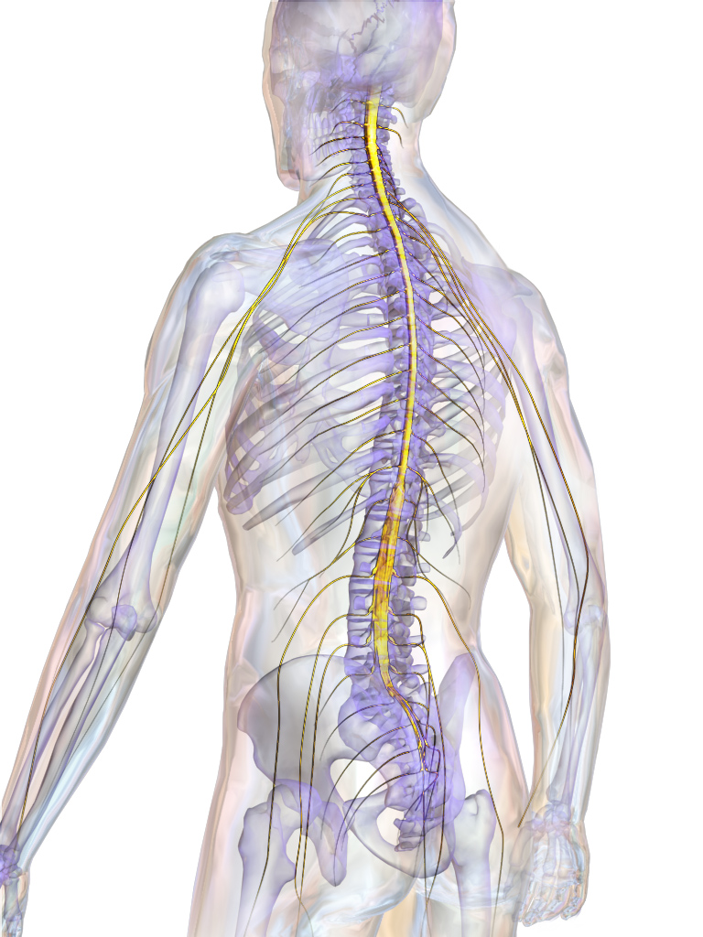
Vertebrates

Slide 4
Invertebrates

Slide 5
Test
Invertebrate
Vertebrate

Slide 6
Invertebrate
Vertebrate

Slide 7
Invertebrate
Vertebrate

Slide 8
Invertebrate
Vertebrate

Slide 9
Invertebrate
Vertebrate

Slide 10
www.ecosystemforkids.com
Science for 1st to 7th Grades

